Slide 1
Leading and managing teams
Dr Vibhav Singh
School of Business Management

Slide 2
leadership
Leadership is the ability to influence a group toward the achievement of a vision or set of goals.
Not all managers are leaders.
Non-sanctioned leadership is often as important or more important than formal influence.

Slide 3
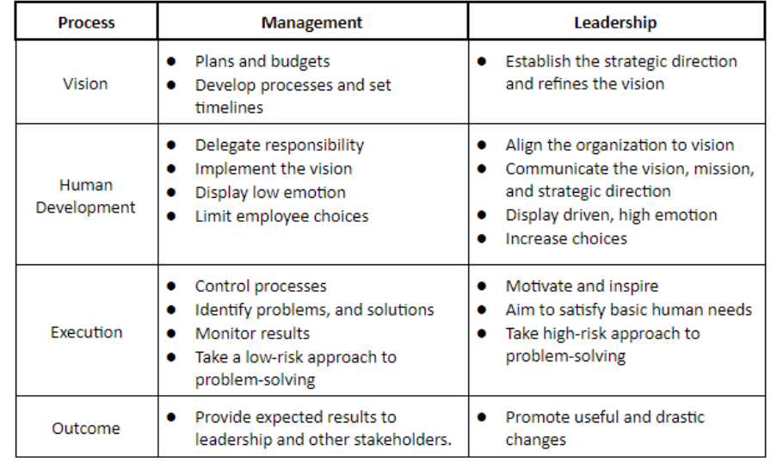
Leaders and managers

Slide 4
Trait theories of leadership
A. Strong Leaders
1. Trait theories of leadership focus on personal qualities and characteristics.
2. Comprehensive reviews of the leadership literature organized around the Big Five framework has found extraversion to be the most important trait of effective leaders, but it is more related to the way leaders emerge than to their effectiveness.
3. Leaders who like being around people and can assert themselves (extraverted) as well as are disciplined and able to keep commitments they make (conscientious), have an apparent advantage when it comes to leadership, suggesting good leaders do have key traits in common.
4. Another trait that may indicate effective leadership is emotional intelligence (EI)

Slide 5
Trait theories of leadership
A. Strong Leaders
6. However, research has demonstrated that people high in EI are more likely to emerge as leaders, even after taking cognitive ability and personality into account
7. Based on the latest findings, we offer two conclusions.
a. First, we can say that traits can predict leadership.
b. Second, traits do a better job predicting the emergence of leaders than they do at distinguishing between effective and ineffective leaders.

Slide 6
Behavioral theories of leadership
Behavioral theories of leadership implied we could train people to be leaders
Ohio State Studies
1. The most comprehensive theories resulted from the Ohio State Studies, which sought to identify independent dimensions of leader behavior.
2. Beginning with more than a thousand dimensions, the studies narrowed the list to two that substantially accounted for most of the leadership behavior described by employees: initiating structure and consideration
3. Initiating structure is the extent to which a leader defines and structures his or her role and those of the subordinates to facilitate goal attainment.
4. Consideration is the extent to which a leader has job relationships that are characterized by mutual trust, respect for employees’ ideas, and regard for their feelings.
a. A leader high in consideration helps employees with personal problems, is friendly and approachable, treats all employees as equals, and expresses appreciation and support.

Slide 7
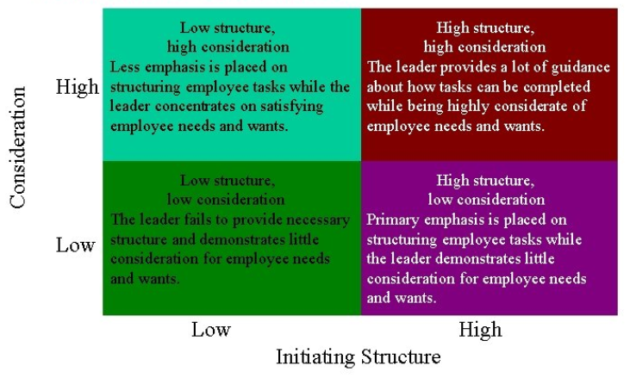

Slide 8
Behavioral theories of leadership
GLOBE Study
1. Some research from the GLOBE study suggests there are international differences in preference for initiating structure and consideration.
a. Based on the values of Brazilian employees, a U.S. manager leading a team in Brazil would need to be team-oriented, participative, and humane.
b. Leaders high in consideration would succeed best in this culture.
c. A leader high in initiating structure (relatively task-oriented) will do best and can make decisions in a relatively autocratic manner

Slide 9
Summary of trait and behaviour theories
Summary of Trait Theories and Behavioral Theories
Leaders who have certain traits and who display culturally appropriate consideration and structuring behaviors do appear to be more effective.
Traits and behaviors do not guarantee success.

Slide 10
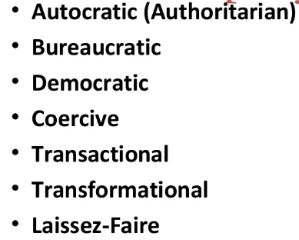

Slide 11
Group dynamics
A group is defined as two or more individuals, interacting and interdependent, who have come together to achieve particular objectives.
Groups can be either formal or informal.
Formal groups: those defined by the organization’s structure.
Informal groups: alliances that are neither formally structured nor organizationally determined.

Slide 12
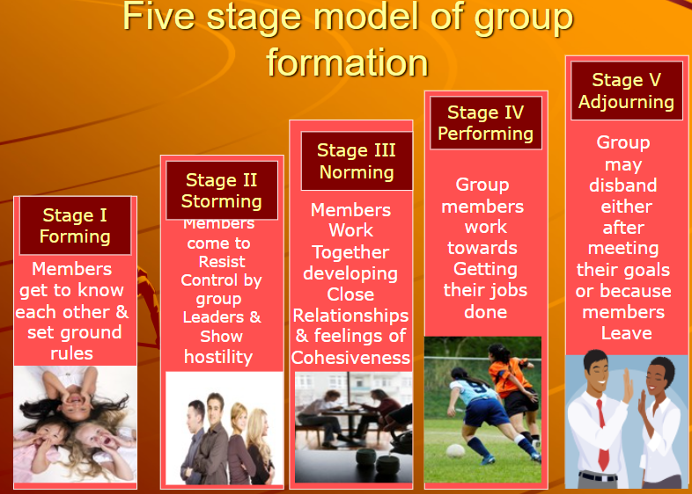

Slide 13
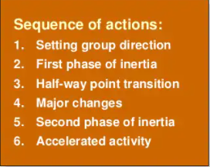
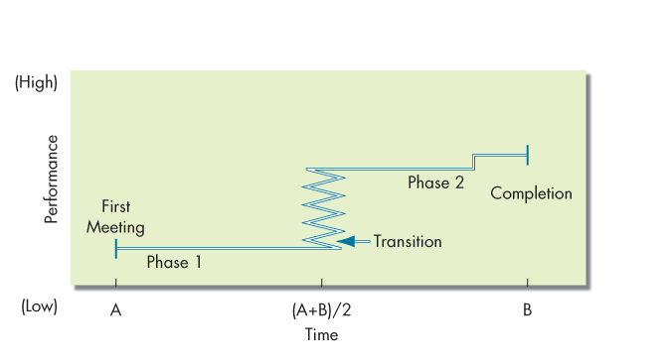
Alternate model for temporary groups
Exhibit 9-1 The Punctuated-Equilibrium Model

Slide 14
Group properties
Roles
Norms
Status
Cohesiveness
Diversity

Slide 15
Role
Role: a set of expected behavior patterns attributed to someone occupying a given position in a social unit.
Role perception: one’s perception of how to act in a given situation.
Role expectations: how others believe one should act in a given situation.
Psychological contract
Role conflict: situation in which an individual faces divergent role expectations.
We can experience inter-role conflict when the expectations of our different, separate groups are in opposition.

Slide 16
norms
Norms:
Acceptable standards of behavior within a group that are shared by the group’s members.
Norms and Emotions
Norms dictated the experience of emotions for the individuals and for the groups – in other words, people grew to interpret their shared emotions in the same way.
Positive Norms and Group Outcomes
If employees aligned their thinking with positive norms, these norms would become stronger and the probability of positive impact would grow exponentially.
Positive group norms may well beget positive outcomes, but only if other factors are present.
Norms and Culture
Do people in collectivist cultures have different norms than people in individualist cultures? Of course they do.
But did you know that our orientation may be changed, even after years of living in one society.

Slide 17
Status and size
Status: a socially defined position or rank given to groups or group members by others.
Status characteristics theory: status is derived from one of three sources:
The power a person wields over others.
A person’s ability to contribute to a group’s goals.
An individual’s personal characteristics.
Status and Norms: high status individuals often have more freedom to deviate from norms.
Status and Group Interaction: high status people are often more assertive.
Status Inequity: perceived inequity creates disequilibrium and can lead to resentment and corrective behavior.
Status and Stigmatization: stigma by association.
Group Status: “us and them” mentality and ensuing polarization.

Slide 18
Status and size
Group size affects the group’s overall behavior.
Large groups are good for gaining diverse input.
Smaller groups are better doing something with input.
Social loafing: the tendency for individuals to expend less effort when working collectively than alone.

Slide 19
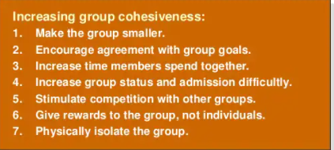
Cohesiveness and diversity
Degree to which group members are attracted to each other and are motivated to stay in group.

Slide 20
Cohesiveness and diversity
Diversity: degree to which members of the group are similar to, or different from, one another.
Increases group conflict, especially in the short term.
Culturally and demographically diverse groups may perform better over time.
May help them be more open-minded and creative.

Slide 21
Group decision making
Strengths of group decision making:
More complete information and knowledge
Increased diversity of views
Increased acceptance of solutions
Weaknesses of group decision making:
Time consuming
Conformity pressures
Dominance of a few members
Ambiguous responsibility
Effectiveness and efficiency of group decisions:
Accuracy
Speed
Creativity
Acceptance

Slide 22
Explain How Organizations Can Create Team Players
Creating Team Players
Selecting: hire team players
Training: create team players
Rewarding: incentives to be a good team player
When not to use teams…
Ask:
Can the work be done better by one person?
Does the work create a common goal or purpose?
Are the members of the group interdependent?
Notes:
Many people are not inherently team players. They are loners or want to be recognized for their own accomplishments. There are also a great many organizations that have historically nurtured individual accomplishments. How do we introduce teams in highly individualistic environments? First, by selecting the right people. Be sure candidates can fulfill their team roles as well as technical requirements.
Second, create team players. Training specialists conduct exercises that allow employees to experience the satisfaction teamwork can provide. Workshops help employees improve their problem-solving, communication, negotiation, conflict-management, and coaching skills. Developing an effective team doesn’t happen overnight—it takes time.
Finally, provide rewards as incentives to be a good team player. An organization’s reward system must be reworked to encourage cooperative efforts rather than competitive ones. Promotions, pay raises, and other forms of recognition should be given to individuals who work effectively as team members by training new colleagues, sharing information, helping resolve team conflicts, and mastering needed new skills. Finally, don’t forget the intrinsic rewards, such as camaraderie, that employees can receive from teamwork. The opportunity for personal development of self and teammates can be a very satisfying and rewarding experience.

